Slide 1



CLIMATE CHANGE
IN
ASIAN COUNTRIES
&
GLOBAL WARMING
MENTOR: DR DIPANJAN GOSWAMI GROUP-1 team members:-
PROF BI IIT DELHI Sai prasad Mohapatra (team lead)
DIRECTOR AI ICTS PVT LTD Kunchalapalli Margaret Clater
Baladev Debasis Jena Siddant Satyanarayana
Bashwant Vegunta Chowdary
HarshavardhanReddy Sadhu
KARTICK CHANDRA JENA

Slide 2
CONTENT:
INTRODUCTION
OBJECTIVE OF STUDY
LITERATURE SURVEY
MODELLING APPROACH
DATA INSIGHTS
PRINCIPAL COMPONENT ANALYSIS
CLUSTERING (K-MEANS & AGGLOMERATIVE)
CLUSTER VALIDATION
STATISTICAL ANALYSIS
MODEL VALIDATION
SAMPLING EFFECTS ON BASE MODEL
BASE MODEL TREE
CLUSTER ANALYSIS
CONCLUSIONS AND SUGGESTIONS
REFERENCES

Slide 3
INTRODUCTION:- CLIMATE CHANGE
Climate change is a depiction of science that has been gen up for many years and The Crux of the matter in recent era is the Global warming.
The bring on this, is the increase in extreme weather events and unbroken series of hottest years on record.
The reduction in temperature can only be achieved through a significant reduction in the emission of greenhouse gases like CO2, Methane, Nitrous Oxide etc. as per The Paris Agreement
The Paris Agreement is an agreement among the leaders of over 180 countries to reduce greenhouse gas emissions and limit the global temperature increase to below 2 degrees Celsius (3.6 F) above pre-industrial levels by the year 2100.

Slide 4
OBJECTIVE OF STUDY:-
Identification Of Major Contributing Factors Towards Global Warming hence Causing Climate Change.
Areas of working which Improvises in Reducing Global Warming.

Slide 5
LITERATURE SURVEY
Study of greenhouse gas emission which mostly rely on energy used by fossil fuel for the features like Energy use kg of oil equivalent per capita, Fossil fuel energy consumption pct of total etc. ,accordingly reducing those factors by analyzing their behavior.
Boosting energy efficiency, green transportation, reviving renewable energy phasing out fossil fuel electricity, managing forests and agriculture exploring, nuclear energy developing and deploying new low carbon and zero carbon technology, ensuring sustainable development.

Slide 6
MODELLING APPROACH
PROBLEM UNDERSTANDING
DATA UNDERSTANDING
EXPORATORY DATA ANALYSIS
DATA COLLECTION
EXPORATORY DATA ANALYSIS
MODEL BUILDING
FEATURE ENGINEERING
HYPER-PARAMETER TUNING
CLUSTER ANALYSIS
CLUSTERING
PCA

Slide 7
MODELLING APPROACH
•C02emission
•Temperature
•Rainfall
•Socio economic factors
DATA COLLECTION
Hypothesis testing
Data normalization
PCA
Clustering
•Data description
•Missing value identification
•Data Cleaning
DATA
PREPROCESSING
Univariate & bi-variate analysis
EDA
DATA
MINING

Slide 8
DATA INSIGHTS
Natural resource depletion is a major contributor to methane emission. But, it makes a country self-reliant for energy needs.
Forest resources serve as an effective alternative to fossil fuels which is majorly quenched by Forest agriculture.
To add a unit value to forest agriculture and fishing, forest area depletes quadratically.
Forest agriculture evidently helps decreasing CO2 emissions.
Energy use, fossil fuels and Gas sources are major contributor of CO2 emissions.
The major source of production of electricity is still coal.
Importing energy significantly decreases annual methane emissions.

Slide 9
DATA INSIGHTS
Fossil fuel consumption is a major cause for decrease in average rainfall.
Production sector, esp. Cement, is the major contributor of annual CO2 emissions.
Oil being the most dominant energy source for production sector, followed by Coal then Gas.
Increase in GDP per capita leads to increase in CO2 emissions, primarily caused by consumption of resources.
The CO2 emission due to consumption is significantly increasing over time.
With time GDP per capita shows a linear trend (approximately), thus, also CO2 emissions caused by consumption of resources.
Nearly half the CO2 emissions by gas sources is caused by flarings.

Slide 10
DATA INSIGHTS
China, Qatar and Brunei Darussalam have more than 18% of features contributing to more than 90% of data.
Years 2011 to 2016 have more than 40% of features contributing to more than 90% of data.
Years 1961 to 1972 have more than 18% of features contributing to less than 10% of data.

Slide 11
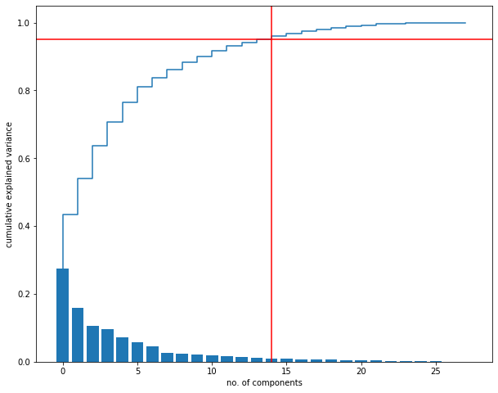
PRINCIPAL COMPONENT ANALYSIS
PCA was performed to reduce multicollinearity.
The objective was to obtain 95% cumulative explained variance.
Hence, 28 features were compressed to 14 PCA components.
By performing PCA, model performance improved and overfitting has reduced.

Slide 12
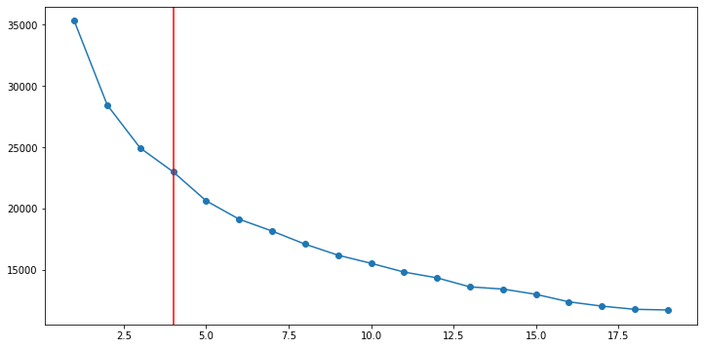
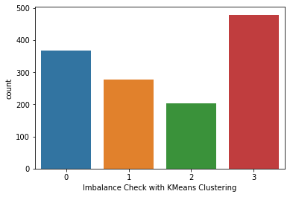

CLUSTERING (K-MEANS)
Four clusters were observed with K-means clustering.
The Silhouette scores for different clusters justify the above finding.
With the cluster labels, as we witness, there is no significant imbalance.

Slide 13
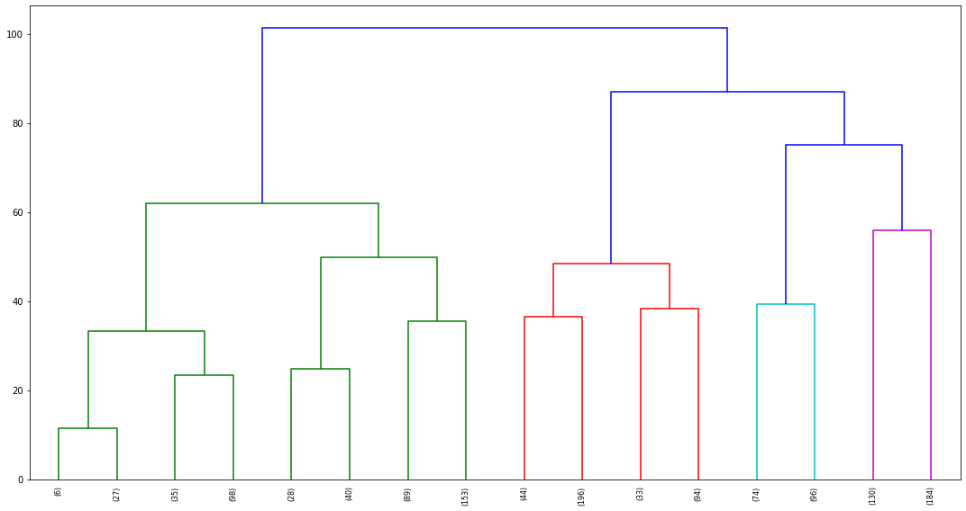
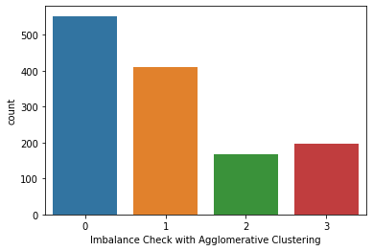
CLUSTERING (AGGLOMERATIVE)
Four clusters were observed with Hierarchical clustering.
With the cluster labels, as we witness, there is no significant imbalance.

Slide 14
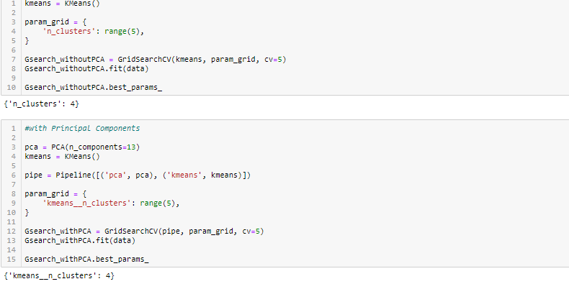
CLUSTER VALIDATION
With Grid Search cross validation, the cluster split above is, thus, justified.

Slide 15
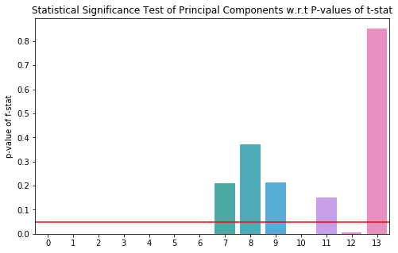
STATISTICAL ANALYSIS
Checking for skewness, it was seen that most of the features among the principal components have Gaussian Distribution.
The T-Tests performed on train and test samples conclude that they are strongly associated with the whole principal component data.
The 7th, 8th, 9th,11th and 13th principal components fail to reject null hypothesis, thus, inferring them to be statistically insignificant features to determine variance in the target.

Slide 16
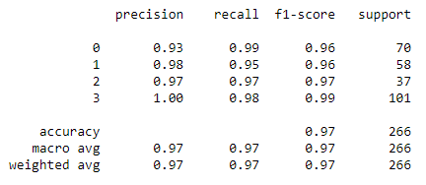
MODEL VALIDATION:
Base Model Inference:-
The accuracy of the model is 97%.
Looking at the F1-scores of each cluster label, we infer the distinction of clusters is high.
Decision Tree Classifier is implemented in order to validate the Clustering.
The table shown here is the Classification report of the base model.

Slide 17
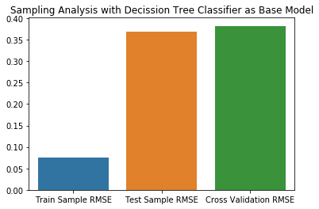
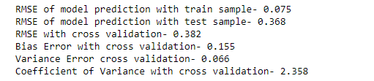
SAMPLING EFFECTS ON MODEL
The base model built with decision tree classifier, as we see- the RMSE of test sample is remarkable higher than train sample’s, is thus underfitting.
This can also be justified with above observed coefficient of variance which portend a higher bias error.

Slide 18
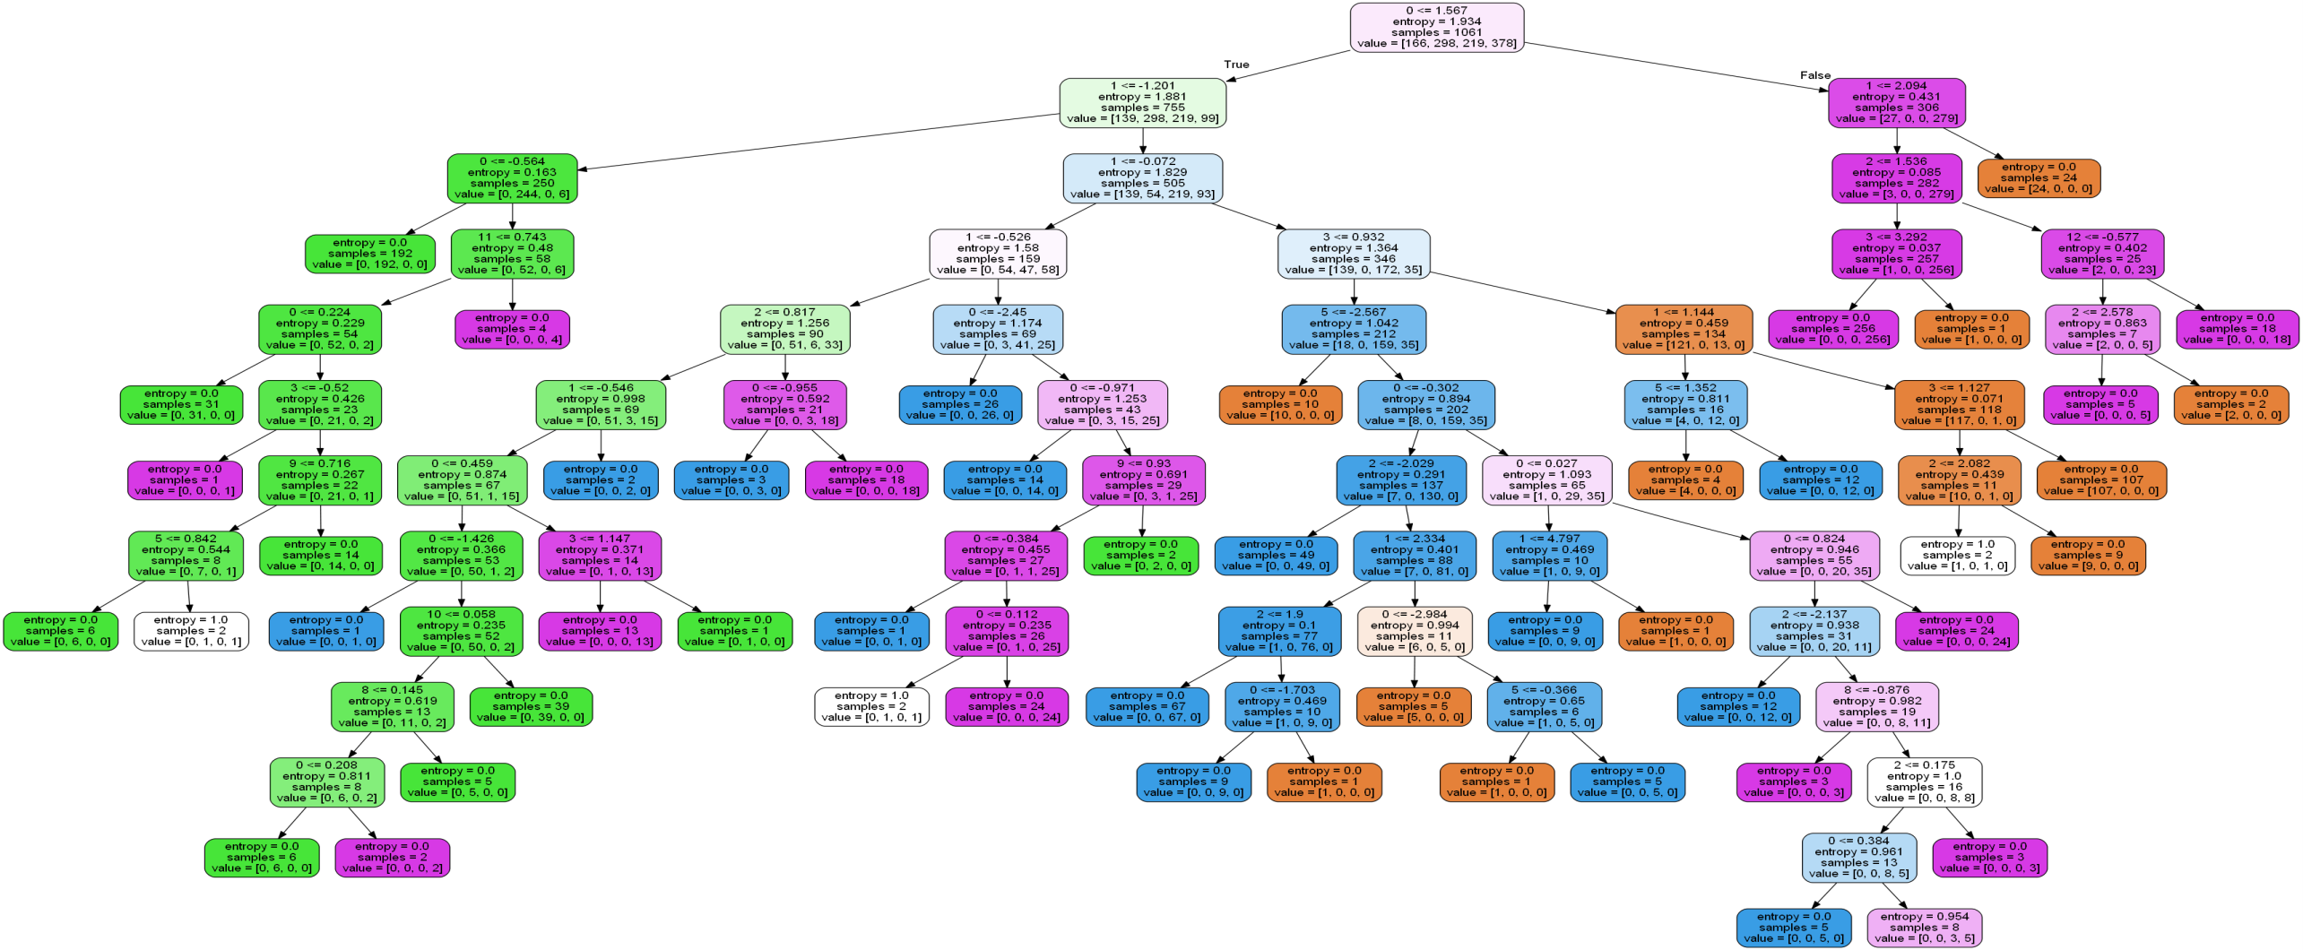
MODEL TREE

Slide 19
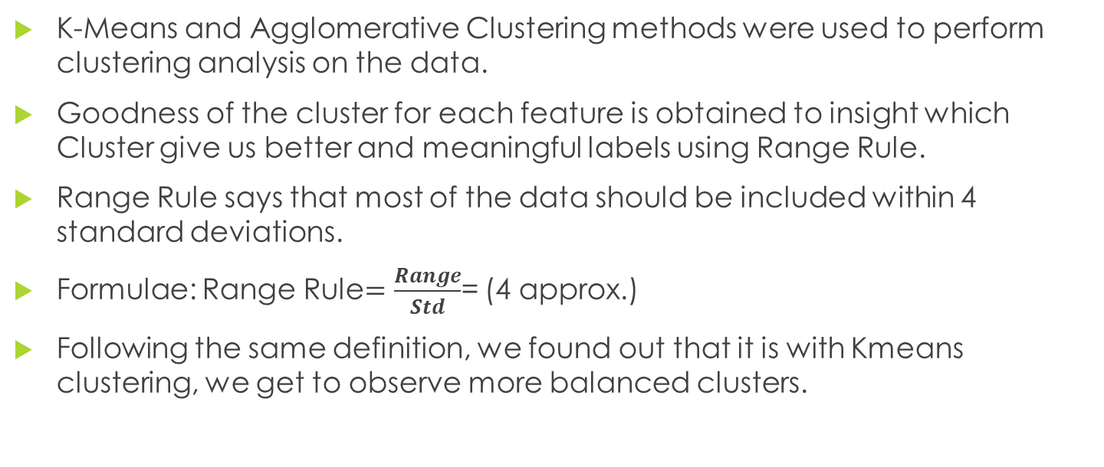
CLUSTERS ANALYSIS
K-Means and Agglomerative Clustering methods were used to perform clustering analysis on the data.
Goodness of the cluster for each feature is obtained to insight which Cluster give us better and meaningful labels using Range Rule.
Range Rule says that most of the data should be included within 4 standard deviations.
Formulae: Range Rule$=\frac{Range}{Std}$= (4 approx.)
Following the same definition, we found out that it is with Kmeans clustering, we get to observe more balanced clusters.

Slide 20
CLUSTERS ANALYSIS
By analyzing the mean and range of all features it was found that cluster labels of K-Means and Agglomerative Clustering match as follows:
With respect to K-Means and Agglomerative Clustering, the cluster behavior is are as follows:
K-Means Clustering | Agglomerative Clustering
0 | 1
1 | 3
2 | 2
3 | 0
K-Means Clustering
Cluster Labels | Behavior
1 | Extreme
2 | High
0 | Moderate
4 | Low
Agglomerative Clustering
Cluster Labels | Behavior
3 | Extreme
2 | High
1 | Moderate
0 | Low

Slide 21
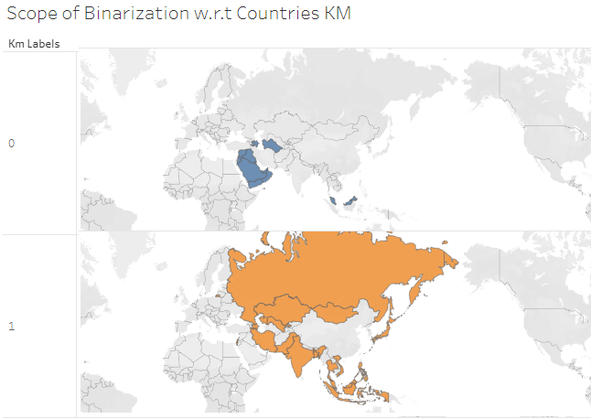
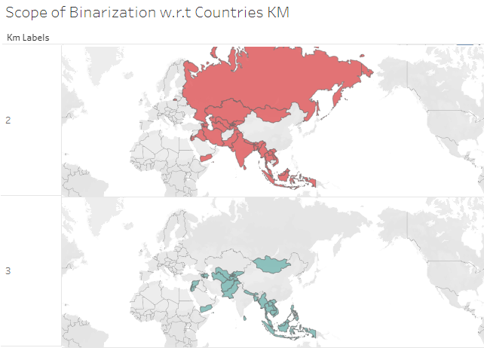
CLUSTERS ANALYSIS

Slide 22
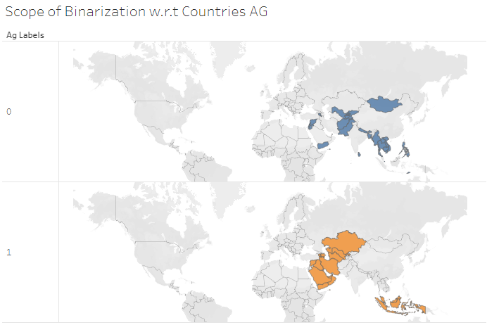
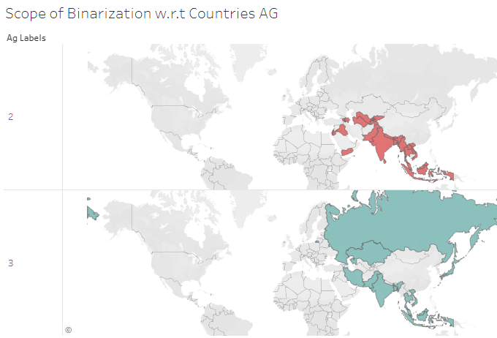
CLUSTERS ANALYSIS

Slide 23
CLUSTERS ANALYSIS
Scope of Binarization-
  Among the features, comparing the common points in between clusters observed with Kmeans and Agglomerative clustering, we found many features that could be merged into 2 clusters instead of 4, since they share the same properties with each other, thus Binarizing the classification labels.
  Along with that, if we see above 2 slides, we’ll see that many countries appear in 2 clusters and not in the other two, highlighting the scope of binarization. Further more, in this case we can choose manually which two clusters to merge in order to binarize, but in the former case, binarization is observed on the basis of commonly shared data points which makes it uniform among all the features.

Slide 24
CLUSTER INFERENCES
From Cluster 0, Saudi Arabia has good share on production sector globally and Kuwait high on CO2 emission.
From cluster 1, Russian Federation ,Japan and India contribute more to commercial productions and Kazakhstan on electricity production.
From cluster 2, Indonesia is good in production sector and Israel on energy imports .
From cluster 3, Lebanon and Mongolia is on rise to produce coal, cement, oil and high greenhouse gases emission.
Most of the countries decreasing their agricultural land which leads to deforestation and poisonous gas emission.

Slide 25
CONCLUSIONS
From all the clusters, commercial production or natural resources depletion related to carbon emission has greater impact on Global warming.
Due to different poverty levels, some countries are depending mostly on commercial production related to carbon emission which can be reduced by providing incentives from global fund.
Research in industries showing alternate to natural resources depletion is much required.
Greenhouse gases emission is too high in some countries to increase their GDP by exporting.

Slide 26
SUGGESTIONS
Developed countries like Japan, Russia need to identify that could stop piling of greenhouse gases.
Most populated countries need to think of securing natural resources for future and learn usage of renewable source of energy.
Each country must contribute their percent to global fund that could stop poverty levels and surplus commercial production.
Stop deforestation that could worsen the level of carbon dioxide in air.
Human must invest on Bio-Fuel, decrease in emission of green-house gases and generate electricity from renewable sources.

Slide 27
REFERENCES
1. Bergmann, P. G. (1993). Relativity. In The new encyclopaedia Britannica (Vol. 26, pp. 501-508). Chicago, IL: Encyclopaedia Britannica.
2. Arno, S. F., & Allison-Bunnell, S. (2002). Flames in our forest: Disaster or renewal? Retrieved from
3. https://www.statisticshowto.com/range-rule-of-thumb

Slide 28


